Slide 1

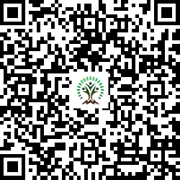


IONIQ Forest
Grid – F Zones 1 -10

Slide 2
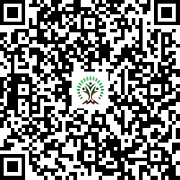
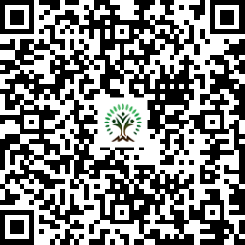
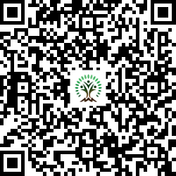
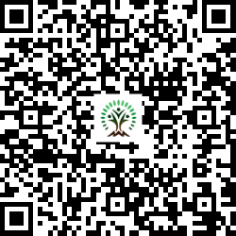
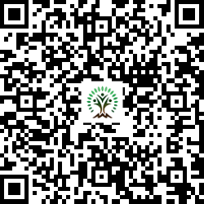
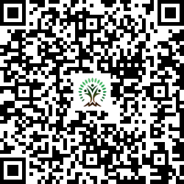
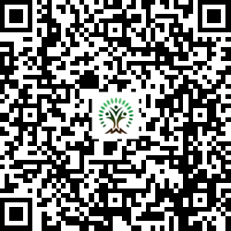
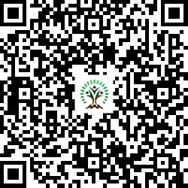
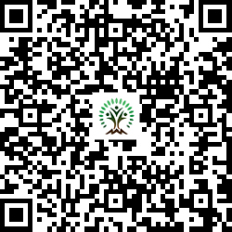
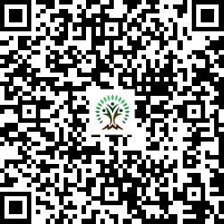
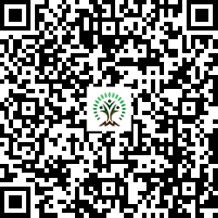
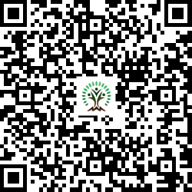
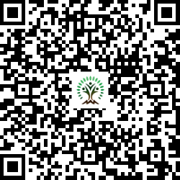
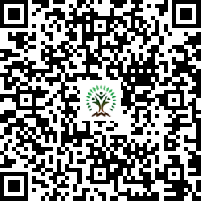
Sr. No. | Scientific Name | Common Name | QR Code
1 | Adenanthera pavonina | Red Sandalwood
2 | Aegle marmelos | Wood Apple
3 | Alstonia scholaris | Blackboard Tree
4 | Anacardium occidentale | Cashew
5 | Annona squamosa L | Custard apple
6 | Azadirachta indica | Neem Tree
7 | Bauhinia variegata | Orchid Tree
Sr. No. | Scientific Name | Common Name | QR Code
8 | Bombax ceiba | Silk Cotton Tree
9 | Butea monosperma | Flame of the Forest
10 | Cassia fistula | Golden shower tree
11 | Dalbergia sissoo | Indian rosewood
12 | Ficus benghalensis | Banyan tree
13 | Ficus racemosa | Cluster fig
14 | Ficus religiosa | Bodhi Tree

Slide 3
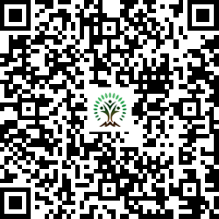
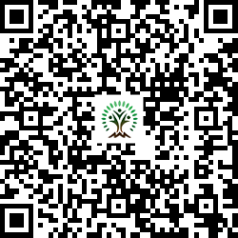
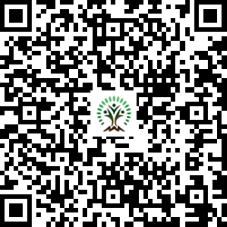
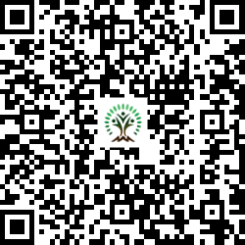
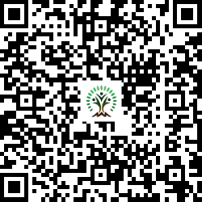
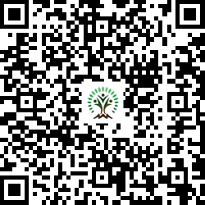
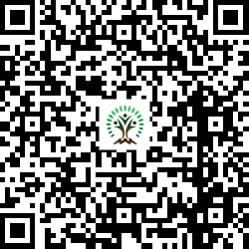
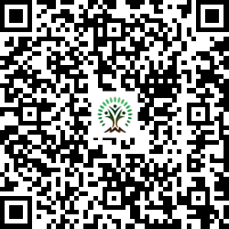
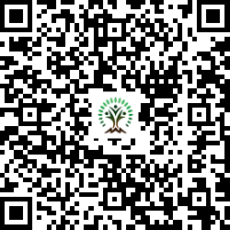
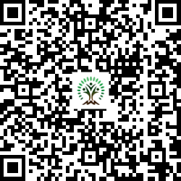
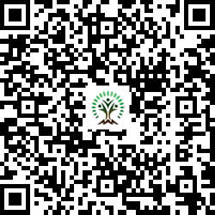
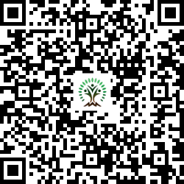
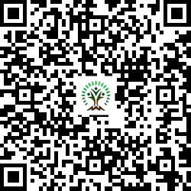
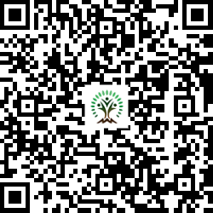
Sr. No. | Scientific Name | Common Name | QR Code
15 | Hiptage benghalensis | Helicopter Flower
16 | Holarrhena pubescens | Ivory tree
17 | Lagerstroemia speciosa | Pride of India
18 | Limonia acidissima | Wood Apple
19 | Madhuca indica | Indian Butter Tree
20 | Mangifera indica | Mango
21 | Melia dubia | Malabar Neem
Sr. No. | Scientific Name | Common Name | QR Code
22 | Mimusops elengi | Spanish cherry
23 | Morus nigra | mulberry
24 | Neolamarckia cadamba | Burrflower tree
25 | Phyllanthus emblica | Indian gooseberry
26 | Pongamia pinnata | Indian Beech Tree
27 | Psidium guajava | Guava
28 | Putranjiva roxburghii | Lucky Bean Tree

Slide 4
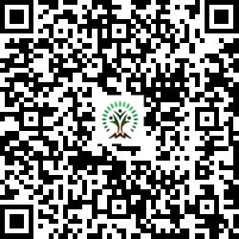
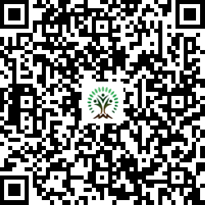
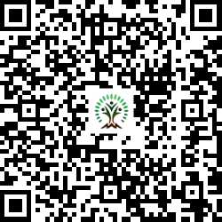
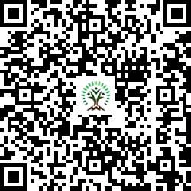
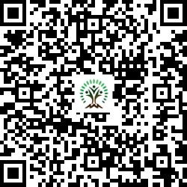
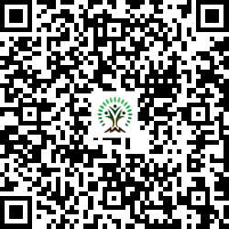
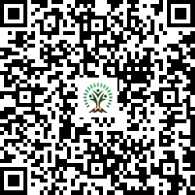
Sr. No. | Scientific Name | Common Name | QR Code
29 | Syzygium cumini | Java plum, Jamun
30 | Tamarindus indica L. | Tamarind
31 | Terminalia arjuna | White Murdah
32 | Terminalia bellirica | Beach almond
33 | Terminalia catappa L | Indian Almond
34 | Thespesia populnea | Indian tulip tree
35 | Toona ciliata | Indian mahogany

